Slide 1
BRM Committee Meeting
Thursday, Oct 9 – 2025
11.00 am – 1 pm.

Slide 2




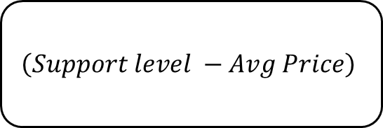
RMP Formula:
Current liability calculation with Provincial support only
$$\left(Support level −Avg Price\right)$$
0.40
Proration,
If any
No. of bushels
$$\frac{1}{2}$$
$$×$$
$$×$$
$$×$$
$$×$$
28,000
farmer-members
The cost of production per bu of a commodity
The avg. six-month price for the main commodities: corn, soybean and wheat – each period: pre-harvest and post-harvest
Provincial support capped at 40%
This is a ratio of total funding available to the total liability generated – expressed as a percentage
Total production in bushels of a specific commodity
Accounts for each period’s payment: Pre-harvest and Post-harvest

Slide 3
RMP Update – Pre-harvest Numbers
Commodity | Payment Estimate ($) | Anticipated Premiums ($) | Bushels Enrolled* | Per Bu Payment Anticipated (after proration)#
Corn | 49,620,658 | 9,651,281 | 212,116,062 | $0.069
Soybean | 62,957,781 | 5,469,736 | 73,815,594 | $0.253
Wheat - SRW | 22,562,422 | 2,097,912 | 41,055,020 | $0.163
Total (Pre-harvest) | 135,140,861 | ~ 19.2 million**
28,000
farmer-members
Anticipated proration at 29.68%
*Bushels enrolled are based on 2024-25 RMP year. Subject to change in 2025-26.
#Per bu amount is calculated net of premiums.
** Sourced from OACC program update.

Slide 4
What would an addition of 60% Federal support mean - conceptually
It is important to remember that there are two aspects of RMP:
  The Liability (or uncapped payments generated from the formula).
  The funding available: provincial (current) + Federal (GFO ask)
Therefore, adding the 60% funding from the Federal govt, will also correspondingly generate a 60% higher liability as well.
However, producers will still benefit because the payment on a per-acre basis will increase.
28,000
farmer-members
This is explained in detail in the next few slides – with a historical comparison

Slide 5






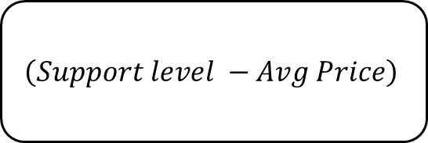

$$\left(Support level −Avg Price\right)$$
0.40 + 0.60
Proration,
If any
No. of bushels
$$\frac{1}{2}$$
$$×$$
$$×$$
$$×$$
$$×$$
Instead of multiplying by 0.40 we would do it by 1 now after the 0.60 from the Feds is added.
Funding available
(assumes $100 million added by 2027)
OASC/GFO Ask
100% Program: Feds + Prov
Provincial portion
Federal portion
Total
28,000
farmer-members
Total Funds for OASC: $250 M
Total Funds for OASC: $375 M
Total Funds for OASC: $625 M
$$+$$
$$=$$
G&O’s share:
$87.5 M
G&O’s share:
$131.25 M
G&O’s share:
$218.75 M

Slide 6
Historical Perspective: How would things change in RMP?
We compare if historical liabilities when both the Federal and Provincial govt are part of the RMP program.
The 2025 numbers are projections.
The joint (Fed + Prov) funding numbers also include the premiums paid by producers from 2021 onwards.
Currently, ON producers pay approximately 31% percent of total Prov govt contribution as premiums.
We extrapolate this to the Federal govt – i.e. if the Feds contribute, then the producer’s will pay a share of the fund as premiums.
Example: In 2024, had the Federal govt contributed to the RMP program, then total liability (Note G&O only) would be $679 million, correspondingly – the payments would also be higher at $241 million.
28,000
farmer-members

Slide 7
Per-acre increase from Fed contribution
$/acre
The pattern fill bar the per-acre increase in payment if the Feds started contributing in the year 2024.
The number is still calculated at 34.8% proration as was the actual case.
Corn is assumed to have a 200 bu/acre target.
Soybeans: 50 bu/acre
SR Wheat: 100 bu/acre
28,000
farmer-members

Slide 8
Conclusion
The increase in 60% funding from the Feds will also lead to higher liability in the program.
However, the benefit will be felt on a per-acre (and per-bu level).
Note also that: premium contributions might also be a factor, since a 60% funding increase from the Feds might also increase premium contribution from the producers.
28,000
farmer-members

Slide 9
Appendix
28,000
farmer-members

Slide 10
Discussion on RMP from the Committee – Next Steps?
28,000
farmer-members

Slide 11
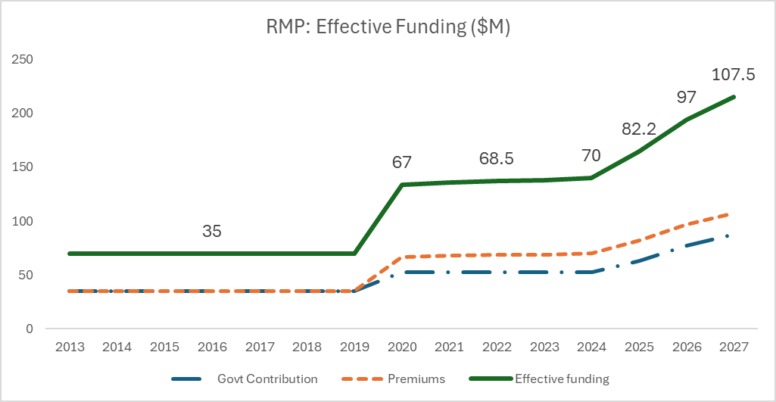
Appendix II
The RMP funding timeline?
28,000
farmer-members

Slide 12
US vs Canada
BRM Programming Comparison Report
2025 Iteration

Slide 13
US vs Canada (ON) – BRM Support Comparison 2025
This report compares Business Risk Management (BRM) support for grain farmers in Ontario, Canada, and Nebraska, US.
The analysis focuses on a representative 1,000-acre corn farm in both regions, evaluating program payments under normal, low-yield and low-price conditions.
What’s new in the updated version?
28,000
farmer-members
Incorporates changes made to:
Crop insurance premium subsidies and support programs
Title I commodity programs
Recently announced Ad hoc payments (both Spring 2025 and potential Fall 2025).
The updated version explains where the “Difference Drivers” are in terms of programming in Canada (ON) and United States.

Slide 14
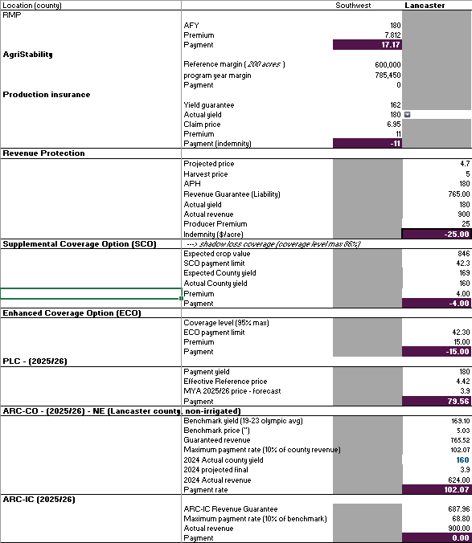
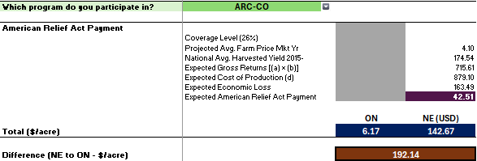
US vs Canada (ON) – Main Results
$/acre
28,000
farmer-members
*There are scenarios, where ON farmers earn more in normal yield, normal price years, due to US crop insurance premiums being higher and no indemnities being triggered and no Title I payments.

Slide 15
Latest on US Ad-Hoc Payments (Fall 2025)
The tentative amount will be between $10-$14 billion. This was reported in WSJ and is not confirmed.
  Republican lawmakers want close to $50 billion, after an economic impact analysis of this year’s crops.
Most of it to cover the US soybean export losses of around $12 billion to China.
  Anticipated payments for Fall 2025
Ironically, the marketing year is not over yet - so China may yet buy beans from the US, given China's demand might be too high for even Brazil and Argentina to fulfill.
Thus, just like 2018/19 US soybean producers might be getting overpaid for their losses - but more analysis will be needed on this. (Source: Giri, Peterson, Sharma – 2018)
The per-acre amount might be around $105/acre for Soybeans (do not cite this –until further clarification!) and lesser amounts for corn and wheat.
But this is not confirmed, it may also vary by state - given the dominance of IL, MN and IA in soybean production.
28,000
farmer-members

Slide 16
Summary of Ad hoc Support Since 2018
Ad Hoc Program ($/acre) | Year | Corn | Soybean | Wheat | Total ($B)
Market Facilitation Program (MFP) | 2018/19 | $111 | $217 | x | $23 B
Coronavirus Food Assistance Payments (CFAP) | 2020/21 | $80 | $80 | x | $22 B
American Relief Act | 2024 | $42.35 | $27.46 | $18.39 | $ 10 B
US Farm Aid (anticipated announcement**) | 2025 (Fall) | ? | $105* | ? | $ 10 – 14 B
*Cannot be cited with certainty yet
** No official announcement yet.
Data sources:
https://farmdocdaily.illinois.edu/2020/06/mfp-and-cfap-payments-corn-and-soybean-uses-and-future-farm-profitability.html
https://www.jstor.org/stable/27098564
https://www.agmanager.info/sites/default/files/pdf/WWW_AmericanReliefAct_01-29-25.pdf
https://digitalcommons.unl.edu/cgi/viewcontent.cgi?article=2057&context=agecon_cornhusker

Slide 17
“One Big Beautiful Bill” (OBBB) Changes
Price Loss Coverage
Agricultural Risk Coverage
Reference prices increased for all covered commodities (starting 2025).
One-time base acre reallocation opportunity starting 2026.
  Election changes — producers can make new elections for 2026–2031 period.
2025 only: automatic “higher of PLC or ARC-CO” payment; no need to elect.
Payment limits increased (see cross-cutting section).
Marketing loan rates increased for major crops.
Payment limits raised: From $125,000 → $155,000 per person/entity.
Base acre updates: opportunity for new allocations (2026).
Payment timing: 2025 crop year changes apply, but payments disbursed on usual schedule (Oct. 2026).
Coverage guarantee raised from 86% → 90% of benchmark revenue.
Maximum payment rate (cap) increased from 10% → 12% of benchmark revenue.
Automatic higher-of payment between ARC-CO and PLC.
Benchmark yield and price calculations remain the same, but higher guarantee increases payout potential.
28,000
farmer-members

Slide 18
RMP vs Title I Programming (US):
what are the actual differences?
The Support level (in RMP) is equivalent to the “reference price”/ “benchmark price” in Price Loss Coverage (PLC) and Agricultural Risk Coverage (ARC).
RMP – Support Level based on the AgriStability data from the preceding three-years.
  GFO has annual input in the pricing.
  Once set – does not change for the season.
  Can be negotiated – to a degree.
  Producer premium for enrollment.
  Higher maximum payment available ($1.2 million for G&O) – but not representative for avg-sized producers
The Reference Price (statutory) in PLC is set by the Farm Bill. Or in the most recent case the One Big Beautiful Bill (where provisions)
  Once set no way to change it.
  But the “effective reference price” has more controls allowed around it and can vary.
  But producers still have no control over it.
  Maximum payment lower: $310,000 per family.*
  No enrollment cost.
*Loopholes may exist, which might enable payments to nephews

Slide 19
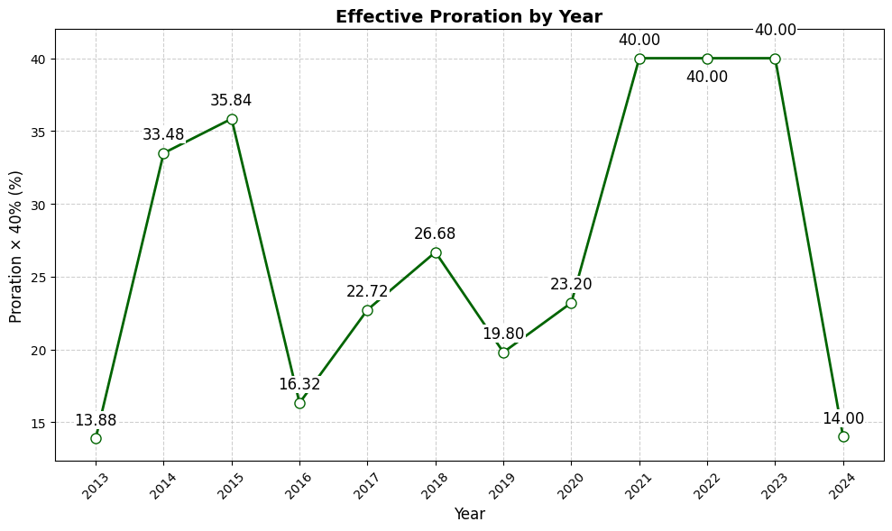
RMP vs Title I Programming (US): The Difference Drivers
RMP
Coverage Level:
  RMP: Maximum true coverage level is 40% due to Federal non-participation. The effective proration is even lower (see chart to the right).
  PLC: 85% coverage level on base acres enrolled.
  ARC-CO: 85% on base acres and 90% on benchmark revenue (increased from 86% last year).
    ARC-CO does have a 12% benchmark revenue cap.
Historical comparison: RMP vs Title I:
A quick examination over the past 7 years will show that RMP has triggered more often than PLC.
  Until 2024.
In comparison ARC-CO often triggers if not on a wide scale, even during years where PLC does not trigger at all.
  Primarily due to county-level yield failure.
Data Sources: OMAFA & https://www.fsa.usda.gov/sites/default/files/2025-09/FSA_ARC%20%26%20PLC_3pg_Fact%20Sheet-SEPT%202025_final.pdf

Slide 20
RMP vs Title I Programming (US):
Explained with an Example
RMP
1,000 acres, 180 bu – corn producer (all values in CAD)
PLC
ARC-CO
Support level | $6.72
Effective Coverage Level | 11.86%
Cash price | $5.42
Total Payment | $27,752.4
Effective Reference Price | $6.14
Coverage Level (BA) | 85%
MYA | $5.42
Total Payment | $110,160
Benchmark Price | $6.99
Benchmark Revenue | $1,259.34
Coverage Level (BA) | 85%
MYA (Actual Price) | $5.42
Actual Revenue | $975.78
Total Payment | $125,934
For the 2025 year, OBBB had a special rule where producers regardless of whether enrolled in PLC or ARC, will receive the highest payment of either: Max(PLC, ARC-CO) – only valid for 2025.
The Maximum payment for PLC/ARC is capped at $215,450 (CAD) ($155k USD).
ARC-CO payment are capped at 12% of benchmark revenue.
All of this payment is in effect driven by a lower MYA, a county-level yield reduction might further increase the payment.
Data sources: OMAFA & USDA (PLC/ARC database) - https://www.fsa.usda.gov/resources/programs/arc-plc/program-data -

Slide 21
Crop Insurance: The Difference Drivers
Canada
Primary differentiator: only yield protection.
No individualized pricing coverage.
Provincial-level customization in insurance programming.
Quality coverage available.
Some area-based programs available in the Prairies.
Private hail insurance (100% producer funded in Manitoba and Alberta)
United States
Primary differentiator: Revenue Protection.
  Offers individualized pricing protection.
  Can be clubbed with area-based programs.
  Coverage level can reach 95%.
  Quality coverage available.
  Private crop insurance agents sell policies.
  Research shows that policies are sold as revenue maximizers, less as risk mitigation.
  Every policy is offered Federally.
  Producers have a choice to exclude their harvest price if they do not contract.

Slide 22
Crop Insurance:
Explained with an Example
Low Yield Example
Projected Price ($/bu) | $6.53
Approved Yield | 180
Coverage Level | 85%
Unit type | Enterprise
Guarantee (PP*AY*0.85) | $999
Producer premium- CI ($/acre) | $34.75
Actual Yield | 135
Harvest Price | $5.42
Actual Revenue | $731.7
Total Payment (Net indemnity) | $232.55
Endorsements | (Lancaster county yield = 160 bu)
SCO – producer premium | $5.56
SCO – coverage level | 90% (buy-up +5%)
SCO – payment | $53.27
ECO – producer premium | $20.85
ECO – coverage level | 95% (buy-up +10%)
ECO - payment | $37.94
US
All values in CAD, commodity: corn
US
Canada (Ontario)
AFY | 180
Coverage Level | 90%
Guarantee | 162
Premium | $11
Actual Yield | 135
Floating price | $5.42
Total Payment | $135.34

Slide 23
Low Yield and High Price Example
Projected Price ($/bu) | $6.53
APH | 180
Coverage Level | 85%
Unit type | Enterprise
Guarantee (PP*AY*0.85) | $1,224
Producer premium- CI ($/acre) | $34.75
Actual Yield | 135
Harvest Price | $8.00
Actual Revenue | $731.7
Total Payment (Net indemnity) | $109.25
Endorsements | (Lancaster county yield = 160)
SCO – producer premium | $1.11
SCO – coverage level | 90% (buy-up +5%)
SCO – payment | -$4.00
ECO – producer premium | $20.85
ECO – coverage level | 95% (buy-up +10%)
ECO - payment | -$15.00
US
Normal Yield and Low Price Example
Projected Price ($/bu) | $6.53
APH | 180
Coverage Level | 85%
Unit type | Enterprise
Guarantee (PP*AY*0.85) | $999
Producer premium- CI ($/acre) | $34.75
Actual Yield | 135
Harvest Price | $5.42
Actual Revenue | $975.6
Total Payment (Net indemnity) | -$11.26
Endorsements | (Lancaster county yield = 160)
SCO – producer premium | $5.56
SCO – coverage level | 90% (buy-up +5%)
SCO – payment | $53.27
ECO – producer premium | $20.85
ECO – coverage level | 95% (buy-up +10%)
ECO - payment | $37.94
All values in CAD
Other Scenarios

Slide 24
Crop Insurance: ON compared with Other Provinces
Summary
Crop insurance
We also comprehensively compare BRM programming between the Prairies (SK, MB and AB) and Eastern Canada (Ontario and Quebec).
Since Federal programming is the same across provinces for AgriInvest and AgriStability, holding ANS and reference margins constant, respectively – lead to similar outcomes.
The main comparison was for crop insurance programming.
Ontario benefits relative to the Prairies given the highest possible coverage level in Ontario is 90%.
  In SK, AB and MB – the standard coverage stops at 80%.
Niche programs exist throughout the Prairies, for which Ontario does not have an equivalent program such as:
  Corn Rainfall Index Program (SK)
  Corn Heat Units (SK)
  Hail Insurance (MB and AB) → Fully private
  Contract Price Option (MB).
But none of the programs give a decisive edge over ON’s crop insurance programming.
Once RMP is included, it could be argued that Ontario’s per acre return on programming is the highest relative to the Prairies.
QC’s programming does marginally outperform ON – but by not more than $10-20 per acre.

Slide 25
Conclusion
The main conclusion from this study is that US G&O producers receive better BRM coverage from their programming.
The effect is especially biased in the favor of US programming, when there are “bad” crop years – whether its low yields or prices.
It is, however, fair to say that without the Title I payments and ad hoc payments in the US – BRM programming would look similar in both regions in normal years.
One of the questions that comes up – despite healthy triggers for both PLC and ARC – why the clamor for more and immediate ad hoc funding?
  Similar to AgriStability in Canada the turnover time is a year.
  2025 crop year payments – will only arrive in Oct 2026.

Slide 26
Appendix: Calculations for US programming
PLC Payment = (ERP−MYA)×PLC Yield × 85% × Base Acres
ECO Indemnity = Farm Expected Crop Value × (Trigger Level−Actual County Revenue / Expected County Revenue)
SCO Indemnity=Expected Crop Value × (90%−Expected County Revenue/Actual County Revenue​)
ARC-CO Payment = (Guarantee Revenue − Actual Revenue) × 85% × Base Acres
Resources for PLC/ARC calculations: https://policydesignlab.ncsa.illinois.edu/policy-lab/proposal-analysis/arc-plc-payments
Other calculators:
  Iowa: ARC-CO & PLC Per Acre Payment Estimator for Iowa, 2025-2026
  North Dakota State Univ: https://www.ndsu.edu/agriculture/ag-hub/ag-topics/crop-production/tools/arc-plc-payment-calculator

Slide 27
Questions?
Grain Farmers of Ontario
679 Southgate Drive Guelph, ON N1G 4S2
519-767-6537 or 1 800-265-0550

